Slide 1
Rational B-splines

Slide 2
w₃ = 1

Slide 3
w₃ = 5

Slide 4
w₃ = 1/5

Slide 5
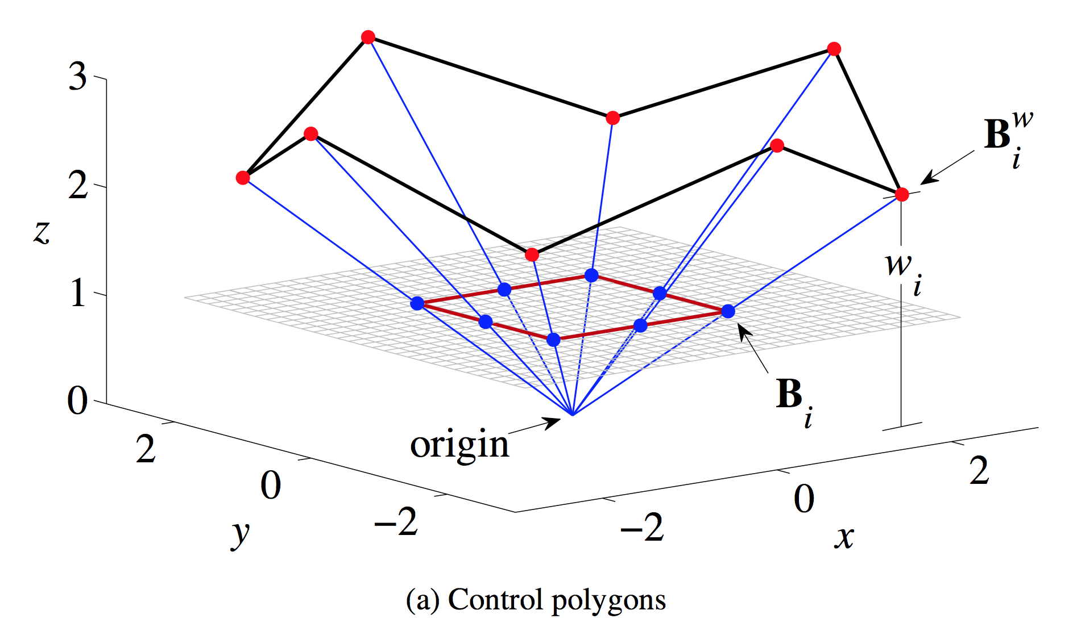
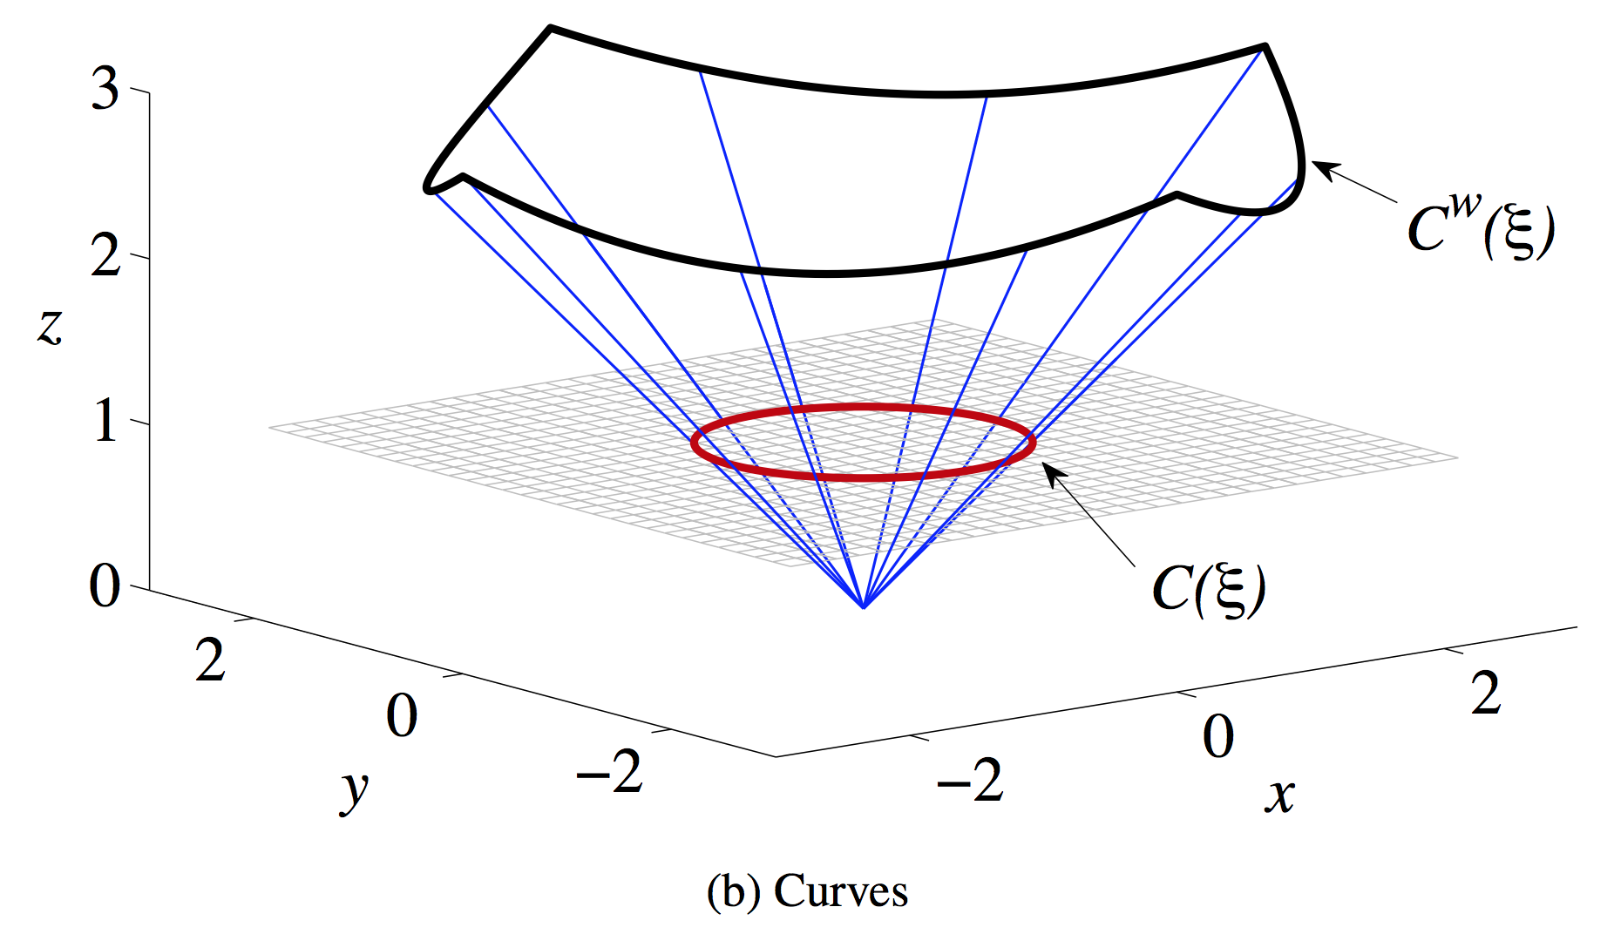

Slide 6
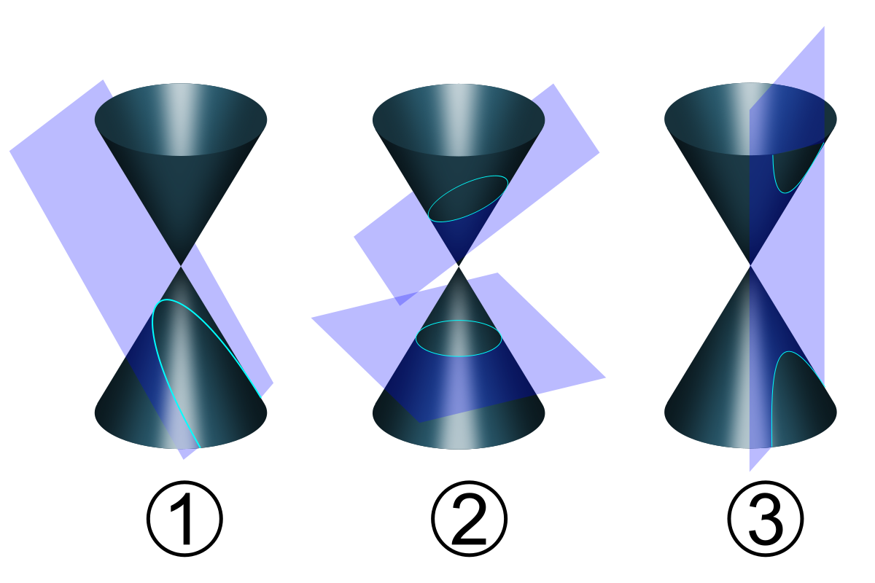

Slide 7
